Slide 1
GBRT: Further Instruction
Fei 15.06.28

Slide 2

Basic idea
For previous prediction $F(X)$, add a new correction $f(X)$
to make Loss as small as possible
$$\hat{f}=\underset{f}{argmin}{\sum_{i}{L\left(yi , F\left(X\right)+f\left(X\right)\right)}}$$
Notes:
建树和调整预测值（delta_{true}，delta_{false}）都依据Optiizaion Goal进行

Slide 3

Idea 1: Gradient based
$$∇_{f(X)}$$

Slide 4

Idea 1: Gradient based
$$∇_{f(X)}$$
$L$ $\left\langle F\left(X1\right),F\left(X2\right),…F\left(Xn\right)\right\rangle$

Slide 5
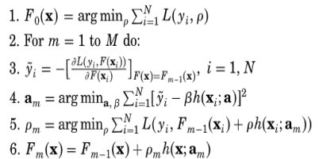
Idea 1: Gradient based

Slide 6

Idea 2: Direct solution
$$\hat{f}=\underset{f}{argmin}{\sum_{i}{L\left(yi , F\left(X\right)+f\left(X\right)\right)}}$$
$$f\left(X\right)=\sum_{r}{Ir(X)θr}$$
$$\hat{f}=\underset{θ}{argmin}{\sum_{r}{\sum_{i}{L\left(yi , F\left(X\right)+Ir(X)θr\right)}}}$$
$$={\sum_{r}{\underset{θr}{argmin}{\sum_{i}{L\left(yi , F\left(X\right)+θr\right)}}}}$$

Slide 7

Idea 2: Direct solution
When L is LSE:
$$\underset{θr}{argmin}{\sum_{i}{L\left(yi , F\left(Xi\right)+Ir(X)θr\right)}}$$
$$={\underset{θr}{argmin}\sum_{i=ir}{\left(yi−F\left(Xi\right)−θr\right)2}}$$
$\hat{θr}=\frac{\sum_{i=ir}{\left(yi−F\left(Xi\right)\right)}}{Nr}$

Slide 8
Prediction on 1-Dimension Data
Prediction
Age
Notes:
每次都在预测（prediction）的基础上继续改进， 使得Optimization Goal变小

Slide 9
Weight Determination
Age
Notes:
蓝色代表要修正的残差

Slide 10
Find Split Point
According to certain criteria(e.g. Least Square Error):
Find a split point
Adjust p
Age<40?
Yes: P+=0.3
No: P-=0.1
p=0.5+0.3
p=0.5-0.1
Age
Notes:
加入预测值调整（P+，P-）后，Optimization Goal进一步减少。
下一次的调整基于新的prediction

Slide 11
GBDT: Prediction on n-Dimension Data
FindBestSplit(sample[] data, double[] P){
foreach dimension d_{i} in data{
foreach SplitPoint v_{split}{
get v_{l} , v_{r}
Count criteria
}
}
Return the best <d_{i} , v_{split} , v_{l} , v_{r} >
}
d_{i}<V_{split}?
Yes: P+=v_{l}
No: P-=v_{r}
Notes:
建树：采用采样的方法，这一点上询问了专业人士，没有更好的办法

Slide 12
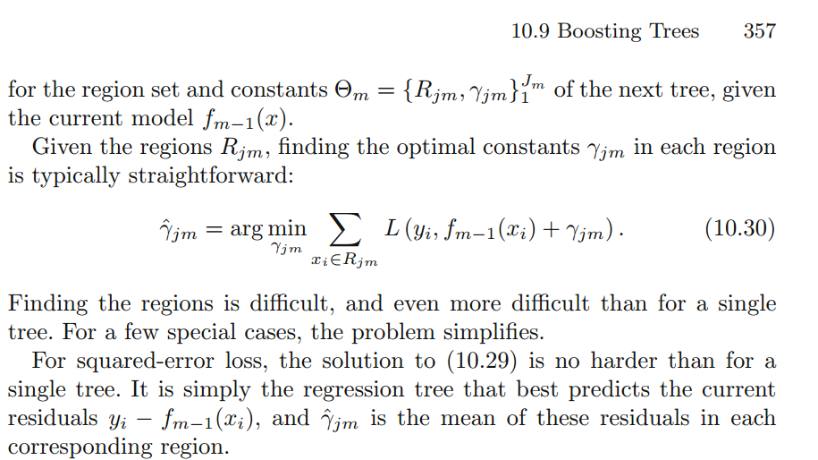
Reference: The Elements of Statistical Learning-Data Mining
Notes:
对于概率调整的计算：在Optimization的标准下选择残差的均值。这一点在《The Elements of Statistical Learning-Data Mining》中有提及。当然如有需要，也可提供具体推导。

Slide 13
age<40?
Yes: 0.3
No: -0.2
Saving<1000?
-0.2
Yes: 0.4
No: -0.5
0.7
-0.2

